Slide 1




Quantum Risk Assesment

Slide 2
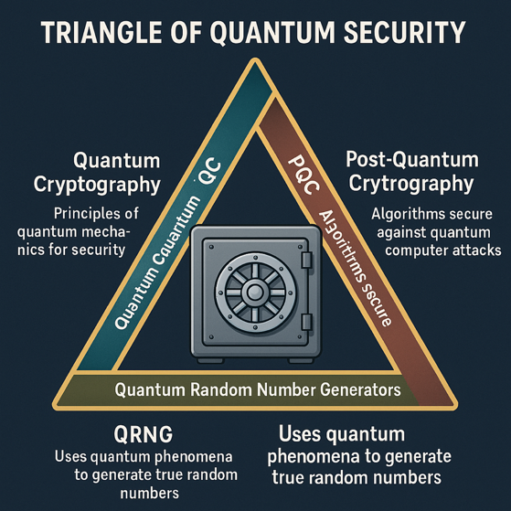
Triangle of Quantum Security (QC + PQC + QRNG)
Security Dimension | Quantum Cryptography (QC) | Post-Quantum Cryptography (PQC) | Quantum Random Number Generators (QRNG)
Principle | Uses principles of quantum mechanics for security (Quantum Communications) | Develops algorithms secure against quantum computer attacks | Uses quantum phenomena to generate true random numbers
Technology | Requires quantum hardware (e.g., QKD systems) | Can be implemented on classical computers | Based on quantum mechanical processes (e.g., photon behavior)
Examples | Quantum Key Distribution (QKD) like BB84, E91, … etc. | Lattice-based (Kyber, Dilithium), Code-based (McEliece), Hash-based (SPHINCS+) | Devices generating true randomness from quantum states of particles
Example (Bank Vault) | Super secure one-time delivery of the combination code (key) for the vault | Replacing the existing lock on the vault with a new, resistant to quantum computers | Generating true random numbers for the combination code (keys) using photons

Slide 3
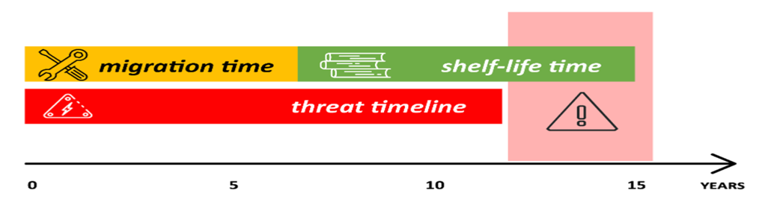
Problem Statement – Cybersecurity Threats of Quantum Computing
Cryptographically Relevant Quantum Computers (CRQCs) are emerging rapidly (Q-Day).
Their increasing capacity (measured by qubits) and development pace pose a significant risk on current Cybersecurity.
These quantum systems can decrypt widely used asymmetric security protocols like RSA or Elliptical Curve algorithms, or AES (just few months ago).
Migration and secrecy maintenance time exceed the expected arrival time of CRQCs
New legal regulations and directives are established in the US, EU, and China to address cryptographic concerns.
Mosca Theorem (x + y > z)

Slide 4
History of Cryptographic Transitions
Period | Event
1970s | Transition to NIST DES from proprietary algorithms
Early 1990s | RSA with 1024-bit keys, MD5, SHA1 widely used
Mid-1990s | Transition from DES to 3DES as AES was being developed
Early 2000s | MD5 found weak; industry moved to SHA1
2001 | AES published, but 3DES still widely used
2002 | NIST published SHA2 suite due to SHA1 concerns
2012 | RSA 1024 → 2048-bit transition
2017 | Google announced SHA1 collision
2020 | RSA-250 (829-bit) was factored; urged shift to 2048-bit
2022 | NIST Round 3 post-quantum algorithm selections announced
2024 | NIST published first tranche of quantum-resistant standards and algorithms (FIPS-203, FIPS-204, FIPS 205)
Q-Day | Shor’s Algorithm (1994) expected to break RSA, DH, ECC AES as well (October 2024)

Slide 5
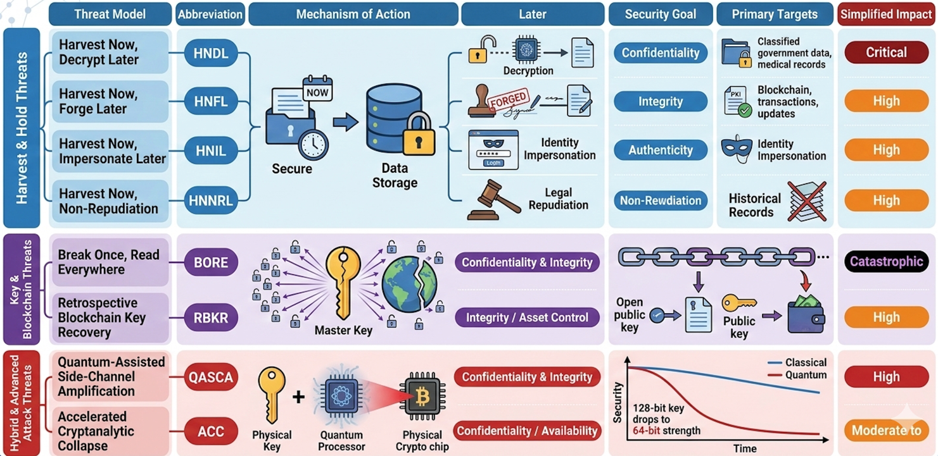
Quantum Threat Models

Slide 6
Quantum-Resistant Standards for New Cryptographic Algorithms
Region / Body | Organization | Key Initiatives & Standards | Notable Algorithms Specifications
United States | NIST (National Institute of Standards and Technology) | PQC Standards - FIPS 203: ML-KEM (Kyber) - FIPS 204: ML-DSA (Dilithium) - FIPS 205: SLH-DSA (SPHINCS+) | ‘-ML-KEM (Kyber): Key encapsulation - ML-DSA (Dilithium): Digital signatures - SLH-DSA (SPHINCS+): Stateless hash-based signatures
European Union | ETSI (European Telecommunications Standards Institute) | Quantum-Safe Cryptography (QSC) - ETSI TS 104 015: Efficient Quantum-Safe Hybrid Key Exchanges with Hidden Access Policies | Covercrypt: Hybrid key encapsulation mechanism with access control
 | ENISA (European Union Agency for Cybersecurity) | PQC standardization and integration | Frameworks for PQC adoption and migration strategies
China | National Cryptography Administration (NCA) | National PQC standardization - Development of quantum-resistant algorithms | Proprietary algorithms under evaluation (not publicly disclosed)
 | Institute of Commercial Cryptography Standards (ICCS) | PQC Evaluation based on security, performance, and feasibility | Ongoing selection process for suitable algorithms
Middle East | - KSA: NCA (National Cybersecurity Authority) - NCS-2:2025 - UAE: UAECSC (Cyber Security Council) National Encryption Policy - Qatar: NCSA (National Cybersecurity Agency) - Strategy 2024–2030 | - KSA: Dec 2025 – Q2 2026: Mandatory submission of PQC Risk Assessments and "Advanced" level crypto-inventories for CNI - UAE: May – July 2026: Entities must submit PQC Migration Plans within 180 days of regulatory "Phase 0" notification. - Qatar: end of 2026: Modernization of financial sector PKI to support hybrid PQC/classical algorithms. | NIST Baseline: ML-KEM (Kyber), ML-DSA (Dilithium). NCS-2 Requirement: "Advanced" level systems must support Crypto-Agility and hybrid key exchange (e.g., X25519 + ML-KEM). Sovereign PQC: TII-optimized versions of ML-KEM/ML-DSA. Spec: Mandatory use of UAE-accredited libraries for "Priority Entities" to ensure digital sovereignty. Hybrid Resilience: Emphasis on dual-signature schemes and QKD (Quantum Key Distribution) for critical fiber backbones in the financial sector.

Slide 7
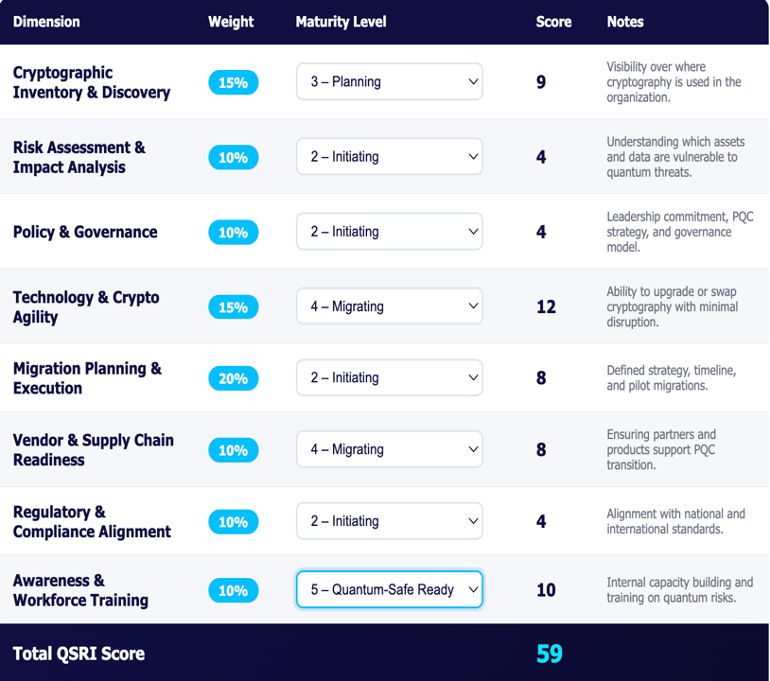
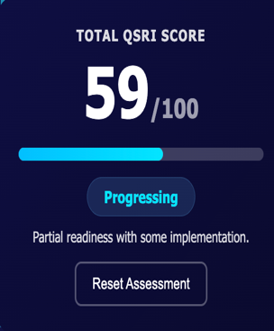
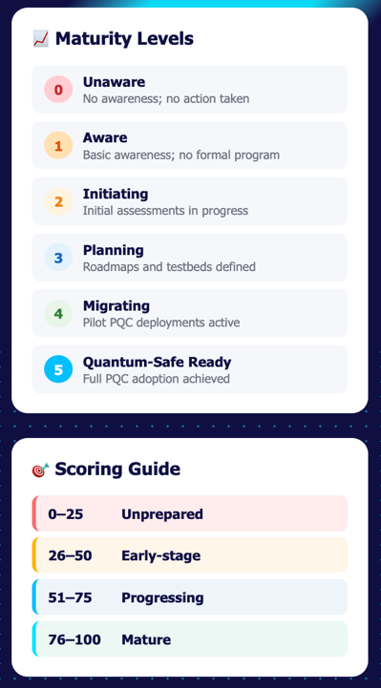
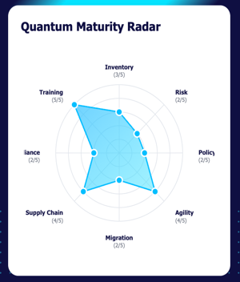
QSRI: Quantum-Security Readiness Index Assessment

Slide 8



Quantum Risk Assessment Post-Quantum Cryptography Assessment Service
Crypto Inventory/Health Check
Recommend best practices and unique discovery tools to build Crypto inventory and assess your crypto assets for PQ-readiness.
PKI Health Check
Provide guidance and tools to assess and address the health and risks of PKI system and its readiness for post-quantum cryptography.
Post-Quantum Risk Assessment
Identify the algorithm and data protection risks in business systems, map out migration plan and timeframes, and review governance against best practices for control, compliance, and skills in readiness for post-quantum migration testing and implementation.

Slide 9
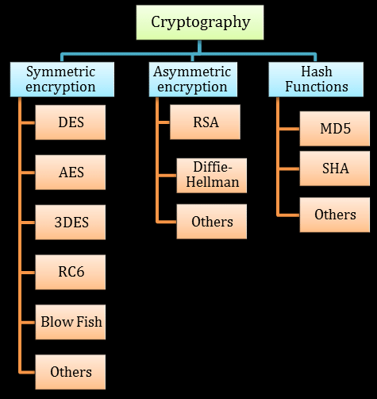
Today’s Classical Cryptographic Algorithms and Protocols
Symmetric Encryption: AES (128/192/256-bit), 3DES, Blowfish.
Asymmetric Encryption: RSA (2048/3072/4096-bit), Elliptic Curve Cryptography (ECC) variants like ECDSA and ECDH.
Hash Functions: SHA-1, SHA-2 family (SHA-256, SHA-384, SHA-512), SHA-3.
Key Exchange Protocols: Diffie-Hellman (DH), Elliptic Curve Diffie-Hellman (ECDH).
Digital Signatures: RSA, DSA, ECDSA.
Cipher Suites: TLS/SSL protocols utilize various cipher suites combining the above algorithms for secure communications.
Cryptographic Libraries: OpenSSL, Bouncy Castle, Microsoft CryptoAPI, and others provide implementations of these algorithms.

Slide 10
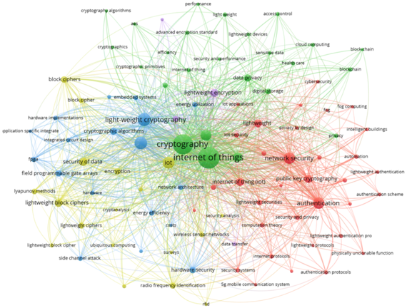
Estimated Cryptographic Algorithm Count (a.k.a. Crypto Inventory Typical Size/Volume)
Per Server/VM: Each server or VM typically employs 20–50 distinct cryptographic algorithms. This includes algorithms used by the operating system, installed applications, and security services.
For example, 100 Servers/VMs: Collectively, a data center with 100 servers or VMs might utilize hundreds of unique algorithms implementation, considering variations in configurations and applications.

Slide 11
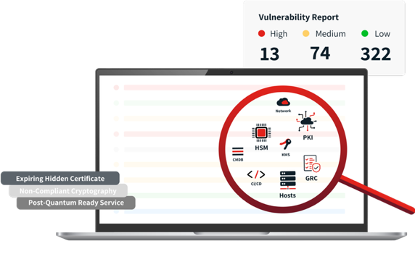
Discovery Tools for Comprehensive Cryptographic Inventory
Static Code Analysis
Dynamic Analysis (Runtime Monitoring)
Network Traffic Analysis
Configuration and System Scanning
Dependency Analysis
Binary Analysis
Cloud Environment Scanning
Hardware and Firmware Analysis
Certificate and Key Management Discovery
Log Analysis

Slide 12

Building a Comprehensive Cryptographic Bill of Materials (CBOM)
CBOM serves as a detailed inventory of all cryptographic components (systems, applications, and IoT devices).
Provides a holistic view of the cryptographic landscape, enabling effective risk management.
CBOM facilitates compliance with regulatory requirements, that are/will be mandated as part of quantum readiness programs.

Slide 13
Sample Cryptographic Bill of Materials (CBOM)
Component | Crypto Algorithm | Library/Tool Used | Key Length Cert Type | Protocol | PQC Readiness | Immediate Action Needed
Web Server (Nginx) | ECDHE-RSA-AES256-GCM-SHA384 | OpenSSL 1.1.1 | RSA 2048-bit cert | TLS 1.2 | Not Ready | Upgrade to OpenSSL 3.0, disable TLS 1.1
Backend API | RS256 (RSA + SHA256) | Java JWT | RSA 2048-bit | HTTPS | Not Ready | Prepare for PQC JWT
Database | AES-256 | Built-in DB encryption | 256-bit | Local Encryption | N/A | Rotate keys periodically
Mobile App Client | TLS 1.2, Cert Pinning | Mobile SDK (native TLS) | RSA 2048-bit cert | HTTPS | Not Tested | Test PQC readiness
Cloud KMS | RSA-3072 | Google Cloud KMS | 3072-bit key | API | Evaluating Kyber | Add PQC support (Kyber)
Auth System | HMAC-SHA256 | OAuth2 library | SHA-256 | OAuth 2.0 | N/A | Monitor crypto standards
Logging Service | AES-128 | S3 Server-Side Encryption | 128-bit | REST API | No | Upgrade to AES-256

Slide 14
Methodologies of Quantum Risk Models
Model | Core Metric | Best Use Case | Risk Score Type
Mosca’s Theorem (XYZ Inequality) | $X + Y > Z$ (where $X$ = shelf-life, $Y$ = migration time, $Z$ = time to CRQC) | Urgency estimation and determining the need for immediate post-quantum preparation | Binary (Pass/Fail)
QARS (Quantum-Adjusted Risk Score) / PAREK Framework | Weighted composite of Timeline ( $T$ ), Sensitivity ( $S$ ), and Exposure ( $E$ ): $wT \cdot T + wS \cdot S + wE \cdot E$ | Sector-specific prioritization for finance, defense, and critical infrastructure | Continuous Index (0.0 to 1.0)
CARAF (Crypto-Agility Risk Assessment Framework) | $Risk = Timeline \times Cost$ | Evaluating implementation complexity (hard-coded vs. software) and replacement capacity | Categorical (1-4 / Low to Critical) or Maturity Level
QUASAR (Quantum-Ready Architecture for Security and Risk Management) | Readiness matrices (technical, security, and operational scores) | High-throughput environments (Telecommunications) and addressing lattice-based congestion risks | Readiness Levels (PQR)
FS-ISAC PQC Risk Model | Stochastic/Probabilistic scenarios (optimistic, median, pessimistic) | Financial asset prioritization based on "Harvest Now, Decrypt Later" (HNDL) and retention windows | Maturity Level / Probabilistic Risk
QERS (Quantum Encryption Resilience Score) | Normalized hardware-level metrics (latency, CPU load, energy, packet loss, key size) | Operational impact assessment for resource-constrained hardware | Normalized Score (0-100)
IBM Quantum-Safe Readiness Index (QSRI) | 14 indicators across Discovery, Observability, and Transformation phases | Macro-level organizational benchmarking and C-level governance | Maturity Level (0-100 scale)
Migration Readiness Score | Percentage of prepared codebase based on safe, hybrid, and vulnerable algorithm detection | Automated assessment of software source code and CI/CD pipelines | Percentage Score (0-100%)
PQFIF (Post-Quantum Financial Infrastructure Framework) | Automated vulnerability discovery and AI-powered migration orchestration | Securing digital asset ecosystems, institutional wallets, and settlement systems | Maturity Level / Priority Score
SQOUT Framework | Likelihood aggregation across sequential adversarial kill chains (Reconnaissance to Impact) | Vulnerability analysis for quantum communication and QKD networks | Likelihood / Impact Index
F-AHP (Fuzzy Analytic Hierarchy Process) | Fuzzy logic and expert pairwise comparison rankings | Managing ambiguity in human judgment for ranking critical components | Priority Ranking / Weighted List

Slide 15
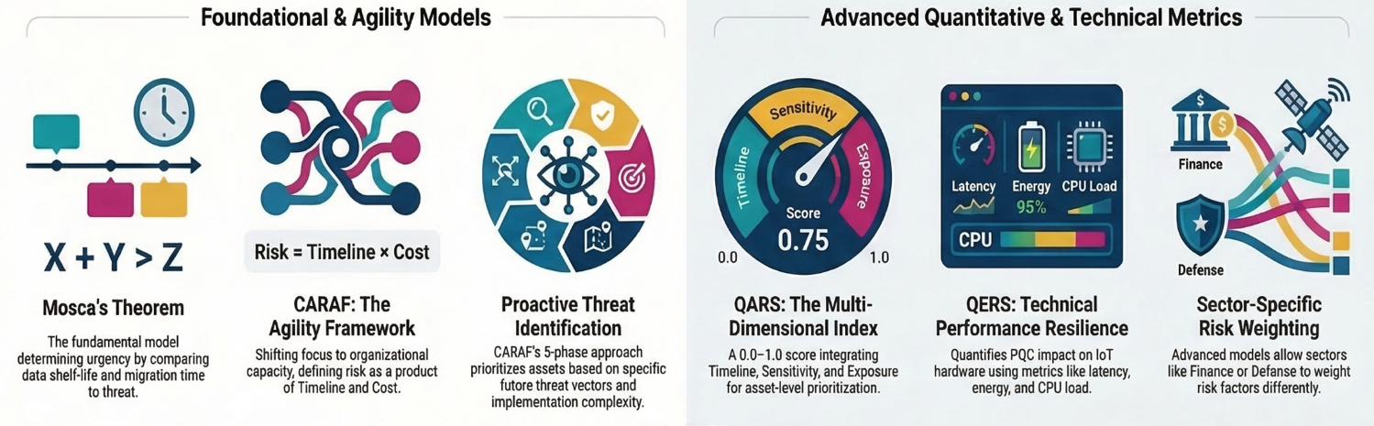
Methodologies of Quantum Risk Models

Slide 16

Quantum Risk Assessment (QRA) based on Mosca's Inequality
X + Y < Z
Variables
Interpretation
▸ X = Data Shelf-Life (years data remains valuable)
▸ Y = Migration Timeline (years to implement PQC)
▸ Z = Threat Horizon (years until CRQC arrival)
▸ If X + Y < Z: Safe margin exists
▸ If X + Y ≥ Z: Critical risk — begin migration immediately
▸ Smaller ratio = Lower quantum risk
CBOM Elements
Regulatory Mapping
▸ Algorithm Type (RSA, ECC, AES, ML-KEM, ML-DSA)
▸ Key Size & Certificate Expiry
▸ Protocol Usage (TLS, IPsec, SSH)
▸ PQC Status & Migration Path
▸ Asset Dependencies
▸ DORA — Digital Operational Resilience Act (EU)
▸ NIS2 — Network & Information Security Directive
▸ NSM-10 — Norwegian Security Framework
▸ NIST PQC — Standardization Timeline

Slide 17
Quantum-Adjusted Risk Score (QARS) & Risk Classification Matrix
1. Timeline Risk (T): r = (X + Y) / Z → T = 1 / (1 + e^(-k(r-1))) where k = 3
// Logistic scaling to 0-1 range
2. Sensitivity Risk (S): Low (0.1) | Medium (0.5) | High (0.8) | Critical (1.0)
3. Exposure Risk (E): E = v × q
v = 0 if PQC protected, 1 if vulnerable q = Harvestability factor (0-1)
Final QARS Score: QARS = (wT × T) + (wS × S) + (wE × E)
Score Range | Risk Level | Action Required | Migration Priority
0.00 - 0.30 | Low | Standard monitoring | Planned / Routine
0.30 - 0.60 | Medium | Enhanced tracking | Near-term roadmap
0.60 - 0.85 | High | Immediate assessment | Active migration
0.85 - 1.00 | Critical | Emergency response | Immediate execution

Slide 18
Sector-Specific Weighting
Sector Profile | Timeline (wT) | Sensitivity (wS) | Exposure (wE) | Rationale
Finance | 0.40 | 0.40 | 0.20 | Regulatory pressure, transaction integrity
IoT / Embedded | 0.50 | 0.20 | 0.30 | Hardware replacement cycles, long deployment
Cloud Services | 0.30 | 0.20 | 0.50 | Multi-tenancy, shared infrastructure risk
General Baseline | 0.33 | 0.33 | 0.34 | Balanced enterprise view
Sample Risk Portfolio
Asset | Sector | QARS Score | Risk Level | Mosca Status
Core Banking System | Finance | 0.924 | Critical | ⚠️ Violation
Identity Provider | Cloud | 0.891 | Critical | ⚠️ Violation
Payment Gateway API | Finance | 0.756 | High | ✓ Safe
Smart Meter Infrastructure | IoT | 0.823 | High | ⚠️ Violation
Serverless Functions | Cloud | 0.142 | Low | ✓ Safe

Slide 19

Hybrid Approach: Immediate Action with Cryptographic Inventory Development
A hybrid strategy that initiates immediate remediation on critical systems.
Simultaneously, building a comprehensive cryptographic inventory.
The most effective path forward, as it:
Addresses the need for quick action
Keep focus on long-term security vision
Allows organizations to demonstrate progress, meet regulatory obligations, and establish a solid foundation for PQC.

Slide 20
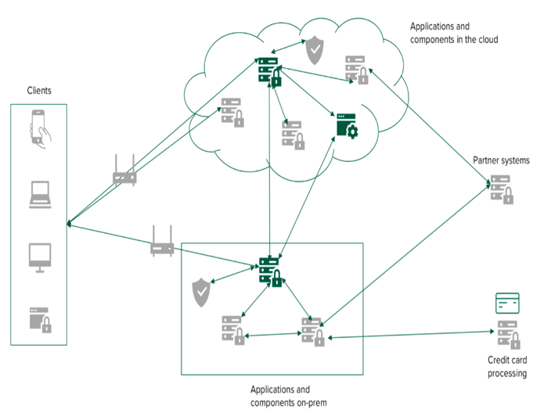
Hybrid PQC Migration & Cryptographic Agility
Cryptographic Agility: The ability to swiftly change cryptographic algorithms in applications and infrastructure as threats evolve or new standards emerge. This ensures future-proofing against "Harvest Now, Decrypt Later" (HNDL) attacks.
Hybrid Migration: An intermediate step combining a classical algorithm (like RSA or ECC) with a post-quantum algorithm (like ML-KEM). This provides redundancy; if one algorithm is compromised, the other maintains security.
Architectural Patterns for Migration
Proxy Pattern: Overlaying an agile security layer on existing components to future-proof legacy systems without requiring a full hardware overhaul.
Upgrade Pattern: Replacing components with versions that natively support NIST-standardized PQC algorithms like ML-KEM (FIPS 203) and ML-DSA (FIPS 204).
QKD Pattern: Utilizing Quantum Key Distribution for short-distance key exchanges that do not rely on mathematical algorithms.

Slide 21
Quantum Risk Assessment Quantum Resilience Strategy Framework Scope Summary
Preparation
Build knowledge of PQC algorithms (e.g., CRYSTALS-Kyber, Dilithium, …etc.).
Inventory systems, protocols, and data sensitivity (e.g., TLS, VPNs, databases).
Prioritize risks using confidentiality lifespan and quantum exposure (e.g., Shor’s algorithm impact).
Implementation
Vulnerability testing (penetration tests, code reviews).
Crypto health checks, PKI readiness, and stakeholder communication.
Develop master plan and budget (phased migration, vendor collaboration).
Remediation
Deploy PQC upgrades, hybrid solutions, QKD, and Zero Trust.
Modernize legacy systems and update key management.
Ongoing Monitoring
Track evolving quantum threats and NIST standards, and annual policy reviews and performance audits.

Slide 22
Quantum Risk Assessment Quantum Resilience Program Outputs/Deliverables
Risk Assessment Matrix: Prioritized list of systems vulnerable to quantum attacks (e.g., RSA-2048).
Crypto Inventory Report: Detailed registry of cryptographic assets (algorithms, key sizes, protocols).
Master Plan Roadmap: Phased migration timeline (critical systems first) with milestones and vendors.
PQC Implementation Guidelines: Documentation for upgrading to quantum-safe algorithms (e.g., CRYSTALS-Kyber for TLS).
Hybrid Deployment Framework: Architecture for integrating classical + PQC during transition.
Budget Draft: Cost analysis for PQC migration (software, hardware, training, downtime).
Training Modules: Workshops for IT/security teams on PQC management and compliance.
Updated Policies: Revised cryptographic and key management policies aligned with NIST standards.
Timeline:
Short-term: Inventory and risk assessment (1-3 months).
Mid-term: Pilot migration and deployments (6 months).
Long-term: Full migration (1–3 years).

